Slide 1
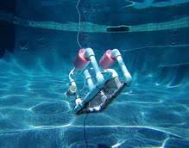


Karetao Hiko Rukuwai
TAWKKM
[marama][tau]

Slide 2
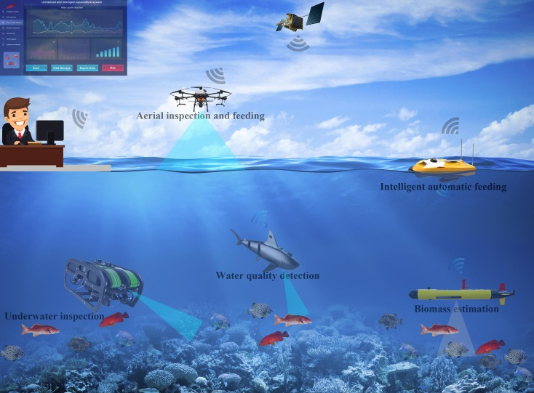
He aha te kaupapa o te karetao hiko rukuwai?
Notes:
He kupu whakataki: Ko te kaupapa o ngā Karetao Hiko Rukuwai (Aquabots) he huarahi auaha hei whakamahi i te hangarau ki te tiaki, ki te āta whakahaere hoki i ngā taiao moana. Mā te whakamahi i ngā momo karetao pērā i ngā topatopa mō te tirotiro i runga, ngā waka aunoa mō te whāngai ika, me ngā karetao ruku mō te aromatawai i te kounga o te wai me te rahinga ika, ka taea te kohikohi raraunga, te whakahaere kai, me te tiaki i te oranga tonutanga o te moana. Ko te aronga matua, kia tūhono ai te tangata, te rorohiko, me te moana hei painga mō ngā reanga kei te heke mai.
Me kī, he waka hōu tēnei hei whakaako i ngā ākonga Māori i te pūtaiao, te hangarau, me te kaitiakitanga i runga anō i ngā mātāpono o te mātauranga Māori.

Slide 3
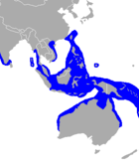
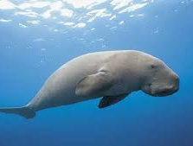
Whakawhanaungatanga
Ko wai koe?
Nō whea koe?
He aha tētehi kararehe e pīrangi nei koe ki te kite i raro i te wai?

Slide 4
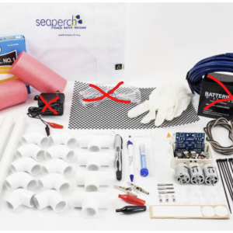
He aha ngā mahi?
Te whakariterite - [mā ngā kaiako e whakarite]
Te rā whakataetae – 13/8 (WLG whakataetae)
Te hanga - [date]
- Te hanga karetao
- Te whakamātautau
Te whakarite kauhau
Te ako mō te patapātai
Te whakarite ngā meka matua
Te hautū karetao
He kauhau
He patapātai mō tētahi kaupapa moana (MOI to provide)

Slide 5
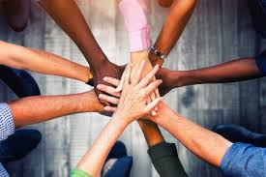
He aha ā tātou tikanga?
“He kaimātai pūhanga tātou”
Me kōrero Māori
Ū ki te mahi
Kia mahitahi tātou
Me ū ki ngā tohutohu
Kia pai te wairua
Kia nohotahi tātou
Ka tū te tangata, nōna te marae
Whakaute atu, whakaute mai
Kia haumaru
Nau mai te hapa
Kore waea pukoro
Whakarongo
Me whakamōhio atu tō tīma ki ngā kaiwhakahaere mēnā e hiahia he wā whakatā/kai timotimo
Notes:
Tikanga - safety, noho tahi, kaua e kai, reo Māori, he kaimātai pūhanga tātou, nau mai te hapa, ma te hapa ka ako, kia ngākau māhaki, whakarongo/ whai i ngā tohutohu, me kāore koe i te mōhio

Slide 6
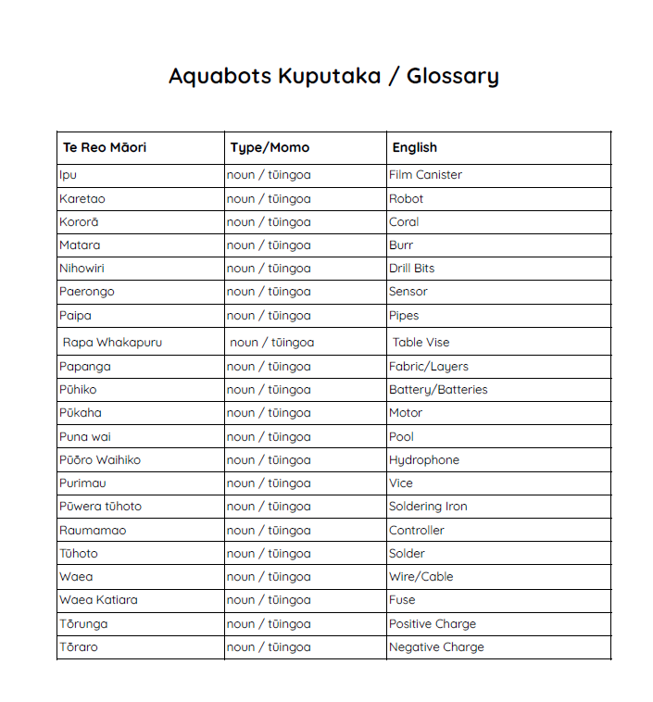
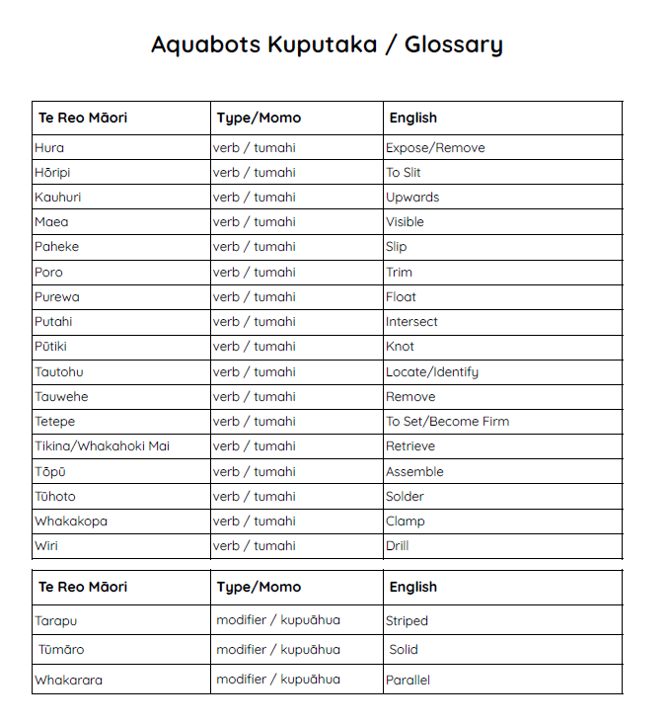
Ngā kupu hou

Slide 7
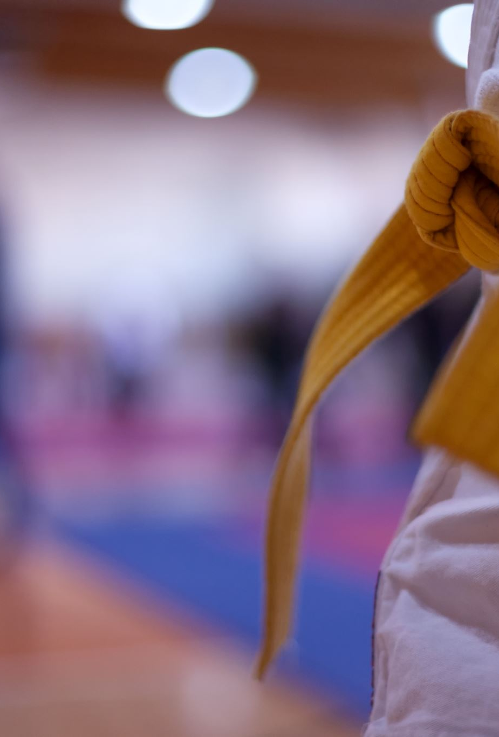
He pātai?
Notes:
Whakamahi nga rauemi kua tukuna ki te awhi i nga whakautu mo nga patai

